Slide 1
WatchOut
Huynh Bao Trung Nguyen, Andreas Stiller, Luke Gavin

Slide 2
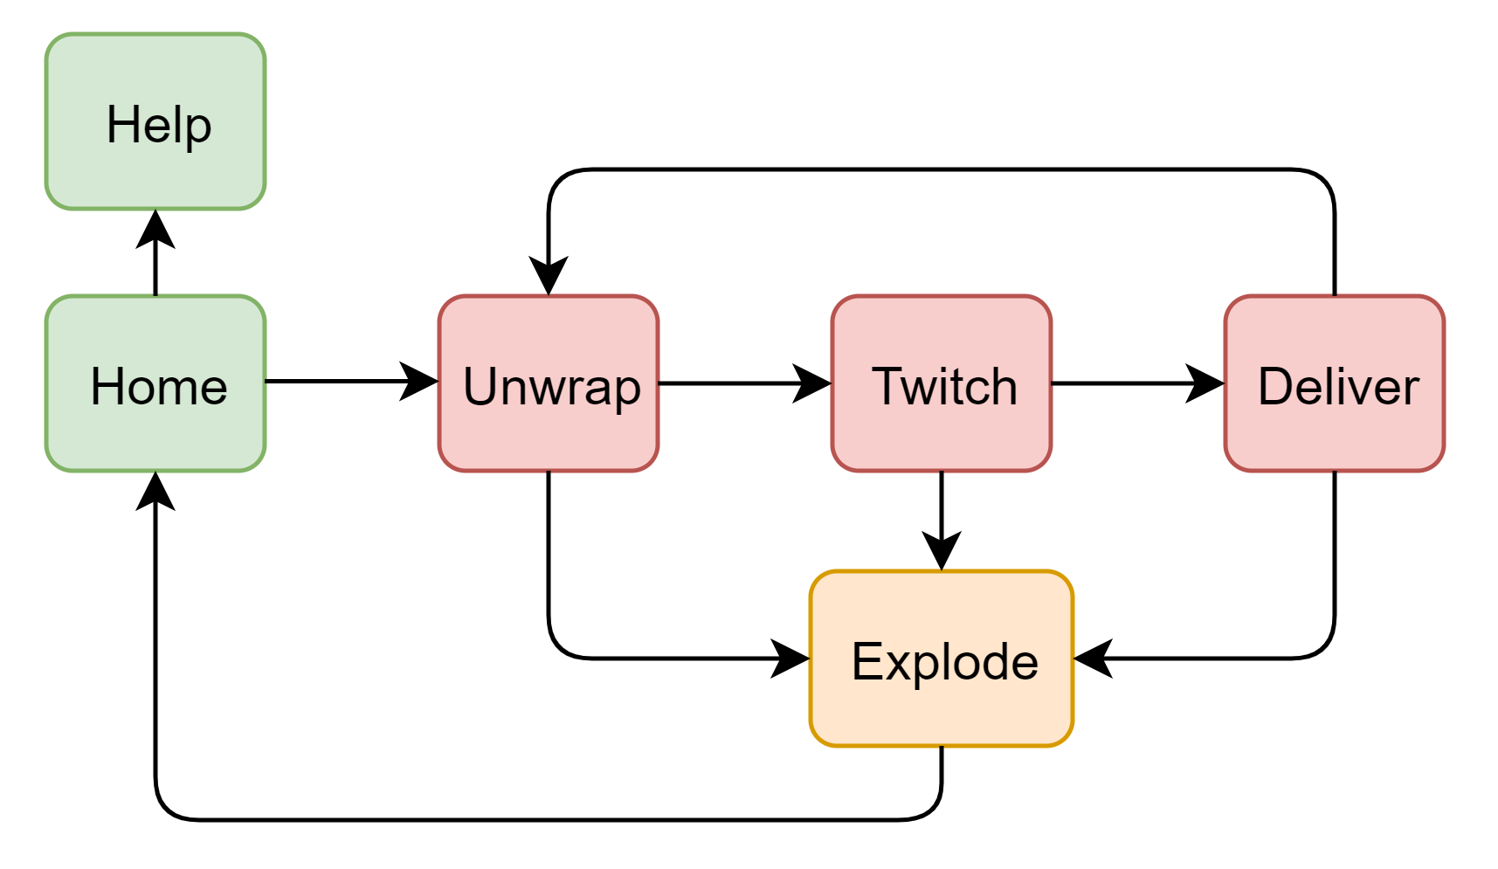
Idea & Design
„Hot Potato“-Game → Bomb-Game „WatchOut“
Players need to solve Tasks and then pass it to another Player
Bomb explodes if its stability is too low
Tasks:
Unwrap
Twitch
Deliver

Slide 3
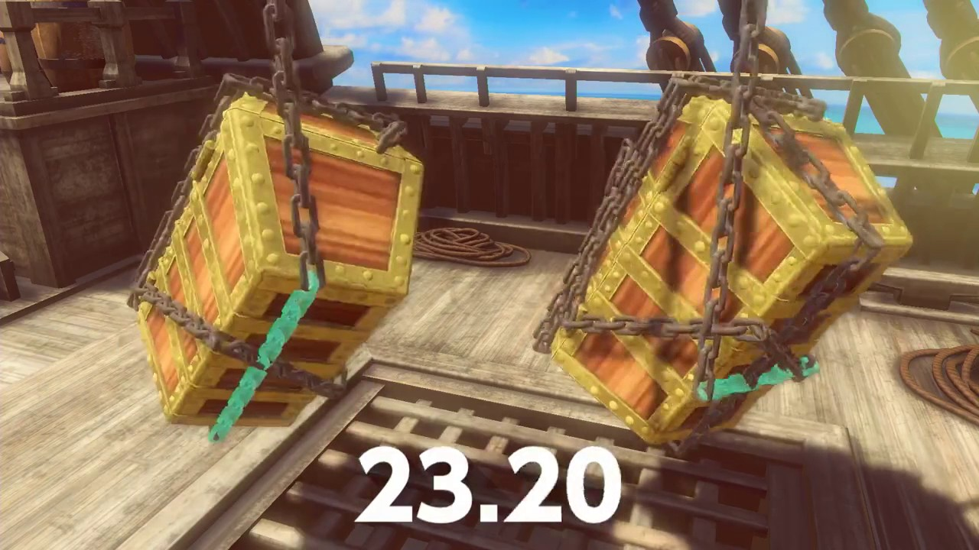
Unwrap
Unwrap in x-, y- or z-rotation

Slide 4
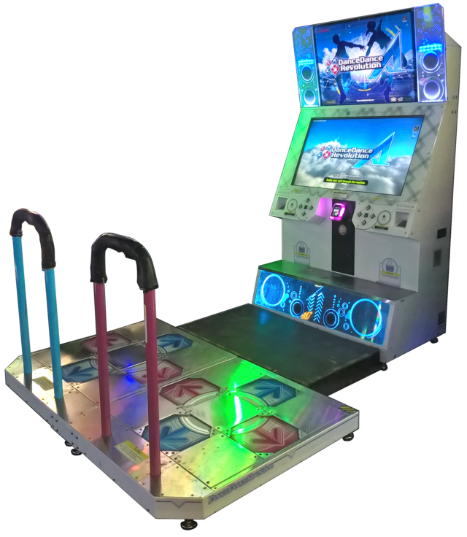
Twitch
Move the iPhone in the shown directions

Slide 5
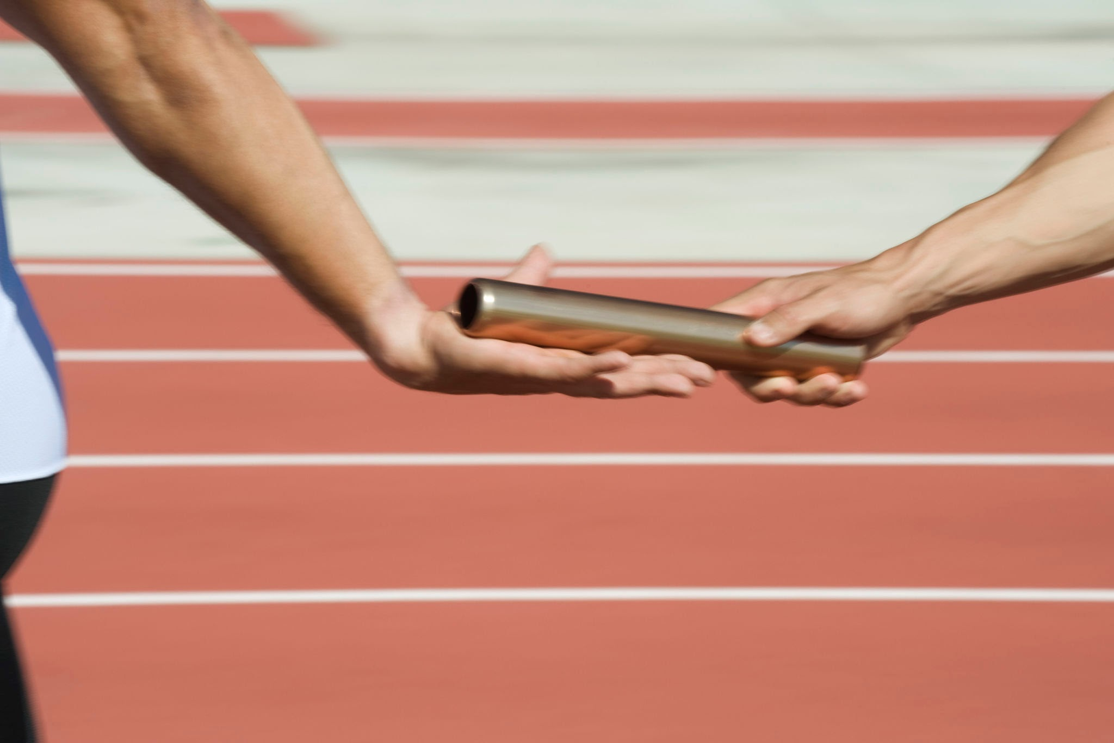
Deliver
Hand the iPhone over to next player

Slide 6
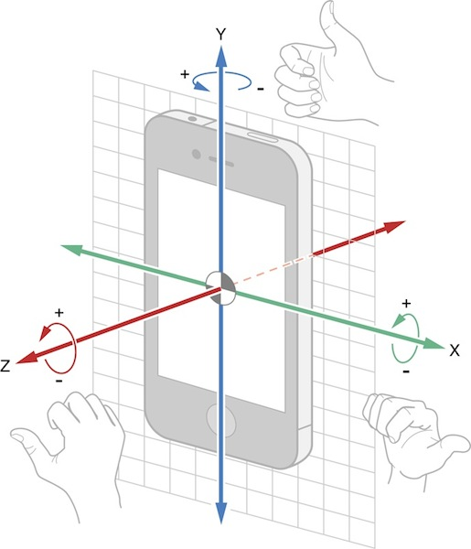


Frameworks
CoreMotion
Rotation
Gravity
Acceleration
Device orientation
ARKit or Camera
Light Sensor
AVFoundation
Play sounds

Slide 7
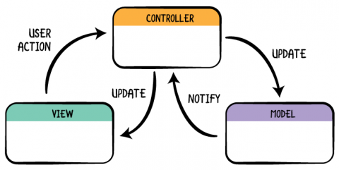
Interesting Encounters
Model-View-Controller (MVC) Hierarchy

Slide 8
Interesting Encounters
How and when to change the bomb stability (updateIntervals)
Explore different tresholds/boundaries for different sensors
Do not overlap with the UI
End a players turn with help of light sensor
Gravity stays the same, if you rotate around the gravity-axis
IOKit LightSensor

Slide 9
Live Demo

Slide 10
Problems (delete this slide later)
One iPhone and macbook
Github merge of main.storyboard
rbi-room is not always available
Start earlier (especially when researching the frameworks)

Slide 11
Thank you for your attention
Any Questions?

